Slide 1
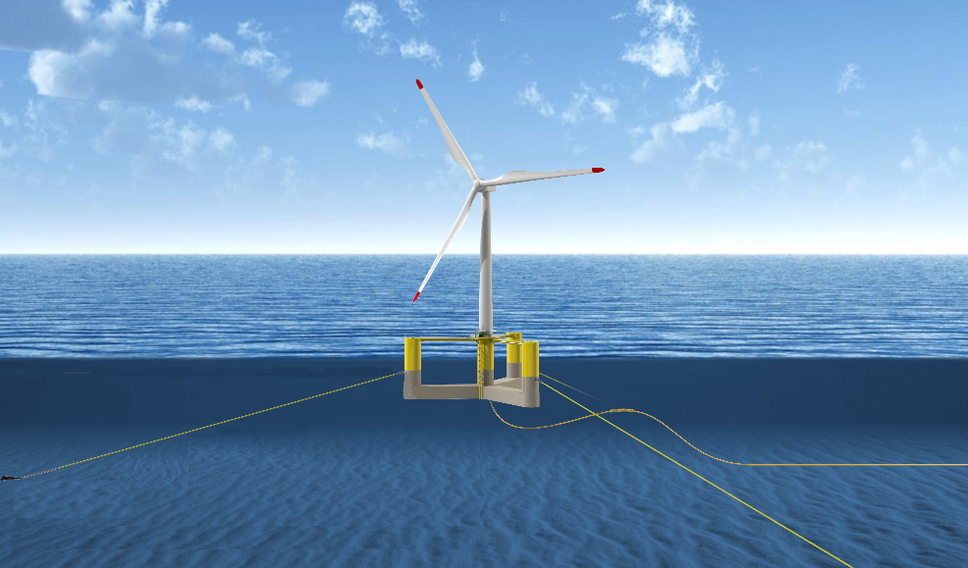
MetOcean GUI Manual
Jack H. Clark
Jack.clark@maine.edu
Version 1.1.1
Created: October 20, 2023
Edited: Jan 24, 2025

Slide 2



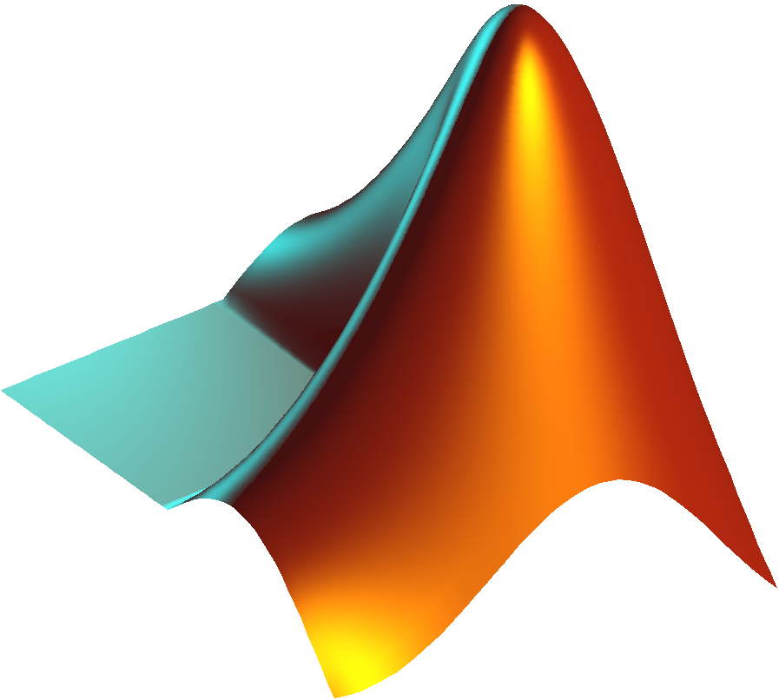



Steps
Required Resources
Installing Python and pip
Installing MHKIT
Installing CDS API
Running the tool
Get the latest .m from git
Install git
How to clone a repo
How to get the latest updates

Slide 3
Required Resources
MATLAB (base)
Python (ERA5)
MHKIT & natsortfiles (toolboxes)
Always try to have the latest stable release of MATLAB.
This tool will not work with older version of MATLAB.
Contact IT to install MATLAB R2022b or later.
Created using R2022b
Last edited using R2022b
Always try to have the long-term stable version of python (LTS).
This tool may not support python versions older than that used during creation.
Details on installing Python will be provided in later slides.
Created using python 3.11.3.
Last edited using 3.11.3.
The NREL Marine and Hydrokinetic Toolkit provides MATLAB access to the U.S. Department of Energy's Water Power Technologies Office wave hindcast data.
Requires python.
More on the toolbox will be provided in later slides.
Natsortfiles comes from a MATLAB toolbox for sorting files.
The toolbox can be found here.
I recommend adding this to your MATLAB path.

Slide 4
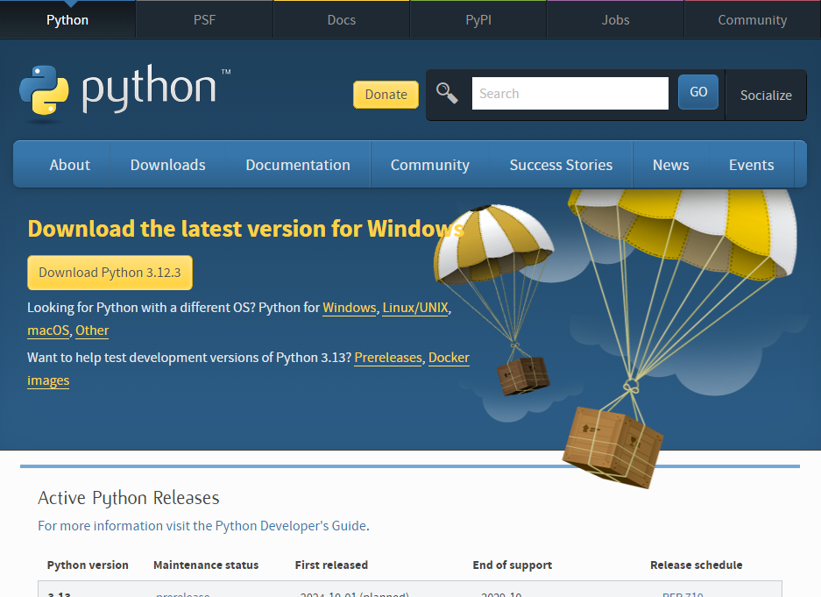
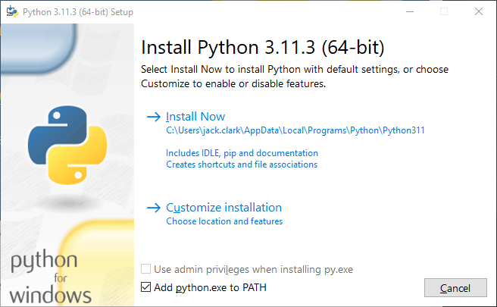
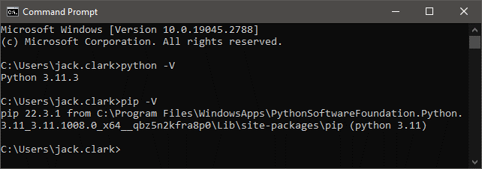
Installing Python and PIP
Scroll Down
Go to https://www.python.org/downloads/
Download and install your preferred version of python. Be sure to check compatibility with your MATLAB version. Check here
Verify that python and pip are installed with the following two commands:
python –V
pip -V

Slide 5
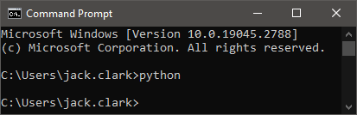
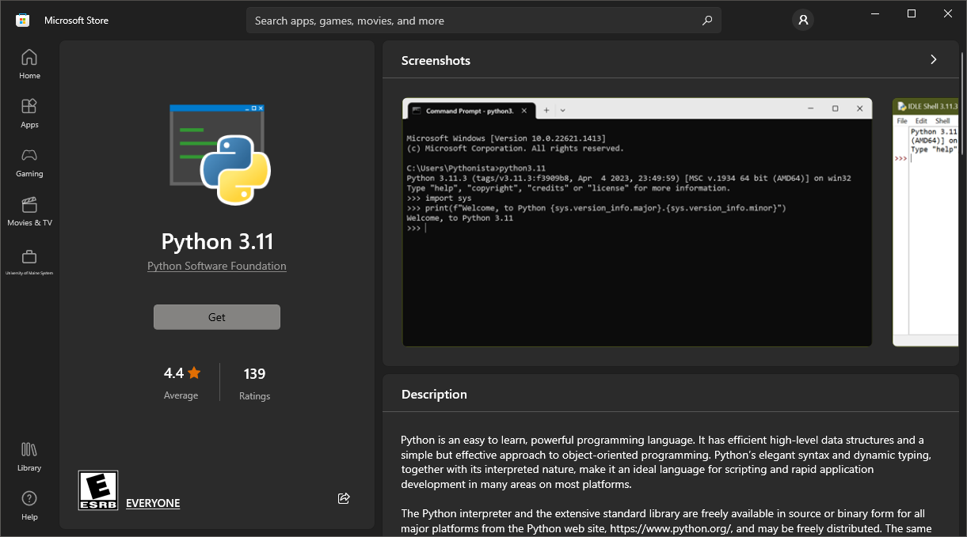
ALTERNATIVE: Installing Python and PIP
Open a command prompt, git bash, or windows PowerShell and enter the following command:
Python
Download and install the most recent version of python listed on the first slide.
Verify that python and pip are installed with the following two commands:
python –V
pip -V

Slide 6
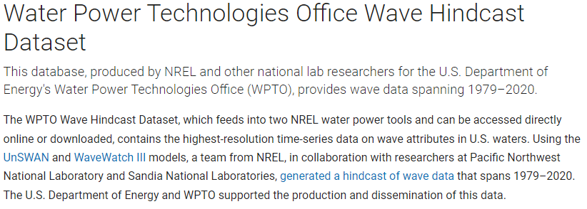
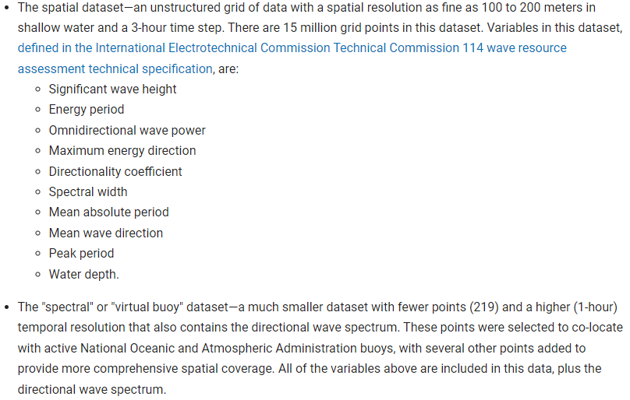
MHKIT and installation guidelines
Go to the following link and follow the detailed installation instructions.
This will generally involve:
Installing the MHKIT python library.
Windows PowerShell, pip, python
Test the python installation.
Windows PowerShell, python
Download the MATLAB toolbox.
Add MATLAB MHKIT to the python environment.
Windows PowerShell, python
Check MATLAB’s python version.
MATLAB
Install the toolbox.
MATLAB
Test the toolbox
MATLAB

Slide 7
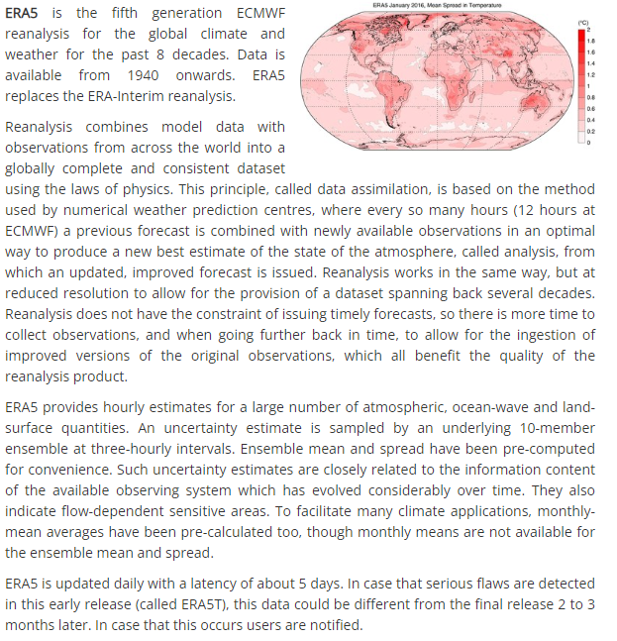
Installing the CDS API (ERA5 dataset)
Detailed instructions for installing the CDS API via pip and python are provided here.
Important Notes:
You will need to make a CDS account to get the api key.
Other than that, all prerequisites should be met, we have already verified python and pip.
Follow the instructions for the CDS API and python version 3 or higher.
You will need to have signed in to your CDS account for the api key to appear in step 2 of the step-by-step guide.

Slide 8
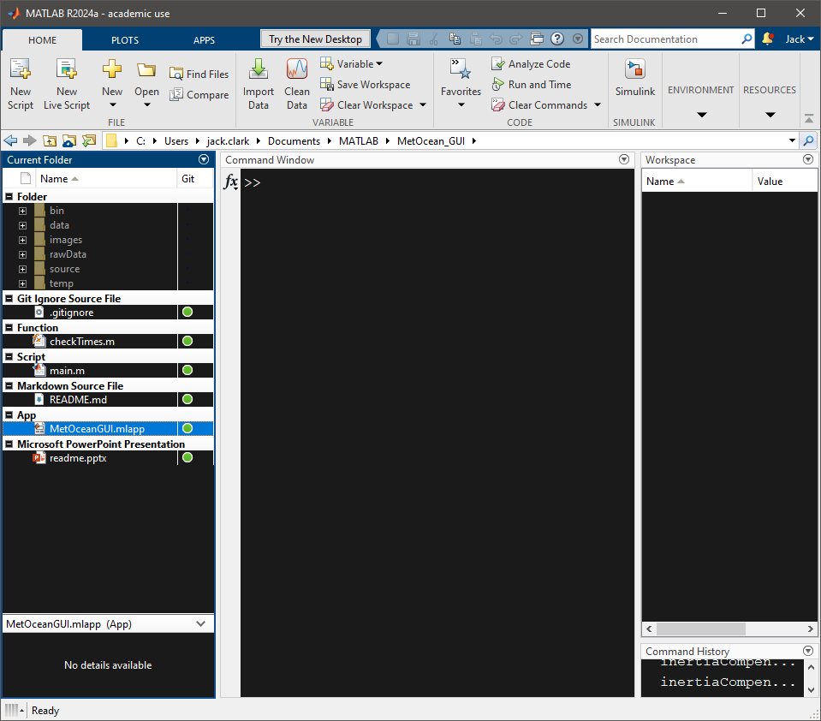
Run the app and download data.
Open a MATLAB instance and navigate to the MetOcean_GUI folder.
It is recommended not to have any additional windows open in this MATLAB instance.
Right click the MATLAB app MetOceanGUI.mlapp and select Run.
Follow the prompts on the screen.
Review the download and hit Submit.
Upon hitting submit, a new instance will open for each data stream that was selected. Some may take a long time. It is recommended to run this process on a separate PC or over the weekend when the windows will not be accidentally closed.

Slide 9
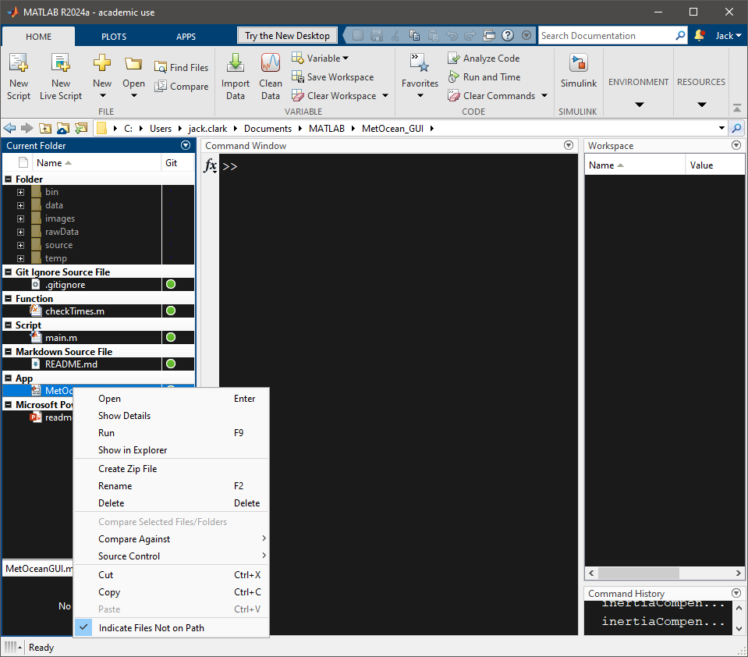
Run the app and download data.
Open a MATLAB instance and navigate to the MetOcean_GUI folder.
It is recommended not to have any additional windows open in this MATLAB instance.
Right click the MATLAB app MetOceanGUI.mlapp and select Run.
Follow the prompts on the screen.
Review the download and hit Submit.
Upon hitting submit, a new instance will open for each data stream that was selected. Some may take a long time. It is recommended to run this process on a separate PC or over the weekend when the windows will not be accidentally closed.

Slide 10
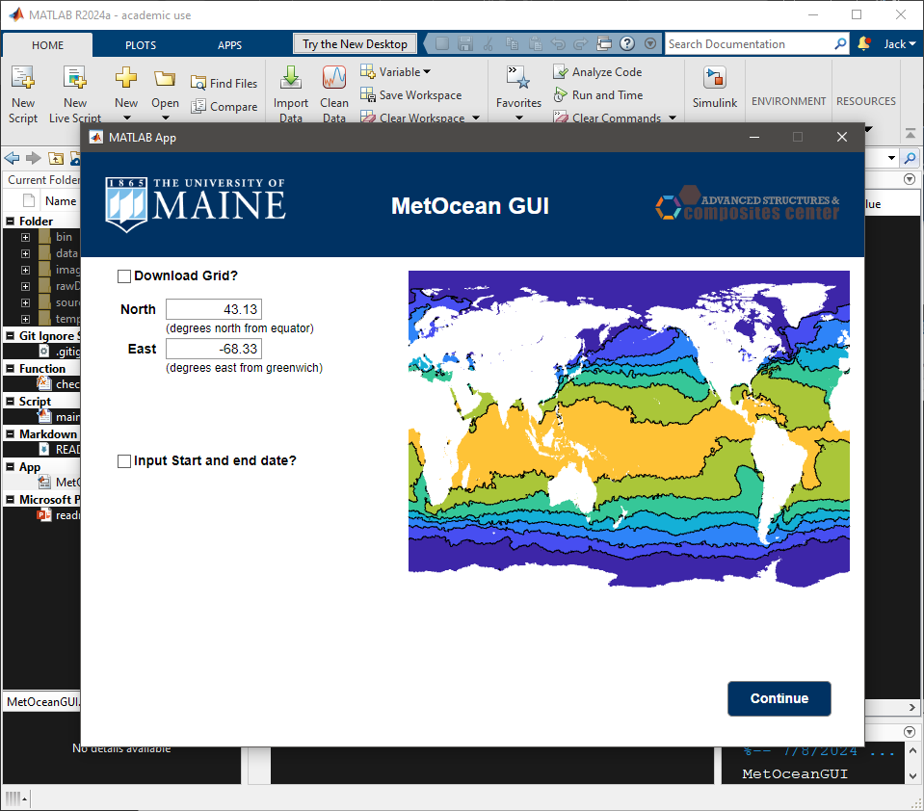
Run the app and download data.
Open a MATLAB instance and navigate to the MetOcean_GUI folder.
It is recommended not to have any additional windows open in this MATLAB instance.
Right click the MATLAB app MetOceanGUI.mlapp and select Run.
Follow the prompts on the screen.
Review the download and hit Submit.
Upon hitting submit, a new instance will open for each data stream that was selected. Some may take a long time. It is recommended to run this process on a separate PC or over the weekend when the windows will not be accidentally closed.

Slide 11
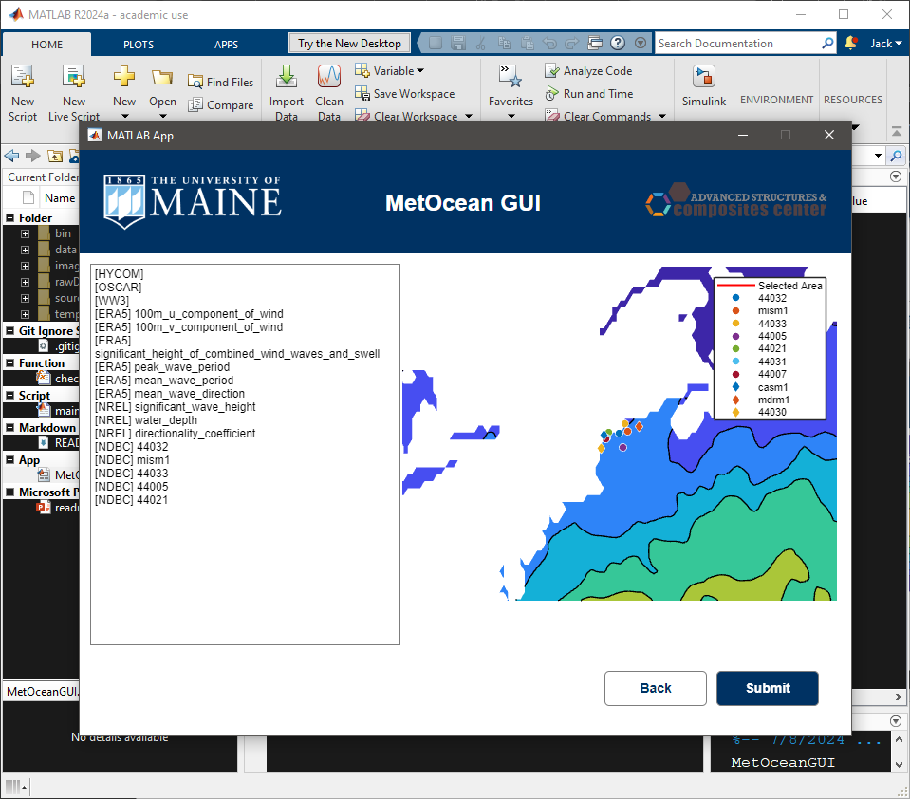
Run the app and download data.
Open a MATLAB instance and navigate to the MetOcean_GUI folder.
It is recommended not to have any additional windows open in this MATLAB instance.
Right click the MATLAB app MetOceanGUI.mlapp and select Run.
Follow the prompts on the screen.
Review the download and hit Submit.
Upon hitting submit, a new instance will open for each data stream that was selected. Some may take a long time. It is recommended to run this process on a separate PC or over the weekend when the windows will not be accidentally closed.

Slide 12
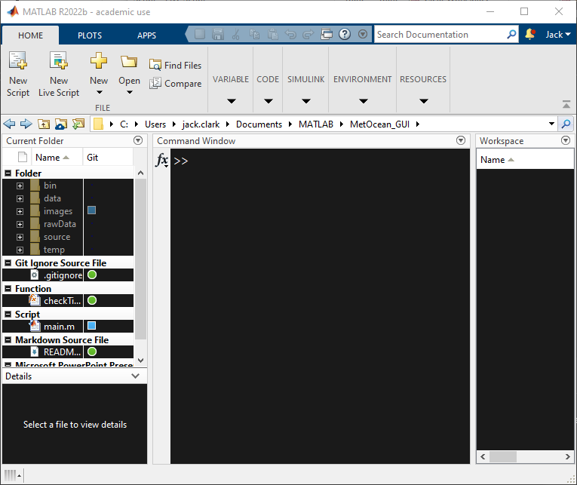
Run the script and download data.
Open a MATLAB instance and navigate to the MetOcean_GUI folder.
It is recommended not to have any additional windows open in this MATLAB instance.
Type main into the command line and hit enter.
Select which data sources you wish to implement.
Input the coordinates of your area of interest, leave south and west blank for a single point.
Select your time frame.
The extractors will each run in separate instances of MATLAB.
The main window will pause this process between each extractor to avoid overwhelming the user and allow variable selection. Make sure to continue!
Select the variables to extract from each source, then continue at the main window.
Wait. Depending on the time and sources selected, this can take a long time (ERA5 can take days to weeks).

Slide 13
Run the script and download data.
Open a MATLAB instance and navigate to the MetOcean_GUI folder.
It is recommended not to have any additional windows open in this MATLAB instance.
Type main into the command line and hit enter.
Select which data sources you wish to implement.
Input the coordinates of your area of interest, leave south and west blank for a single point.
Select your time frame.
The extractors will each run in separate instances of MATLAB.
The main window will pause this process between each extractor to avoid overwhelming the user and allow variable selection. Make sure to continue!
Select the variables to extract from each source, then continue at the main window.
Wait. Depending on the time and sources selected, this can take a long time (ERA5 can take days to weeks).

Slide 14
Run the script and download data.
Open a MATLAB instance and navigate to the MetOcean_GUI folder.
It is recommended not to have any additional windows open in this MATLAB instance.
Type main into the command line and hit enter.
Select which data sources you wish to implement.
Input the coordinates of your area of interest, leave south and west blank for a single point.
Select your time frame.
The extractors will each run in separate instances of MATLAB.
The main window will pause this process between each extractor to avoid overwhelming the user and allow variable selection. Make sure to continue!
Select the variables to extract from each source, then continue at the main window.
Wait. Depending on the time and sources selected, this can take a long time (ERA5 can take days to weeks).

Slide 15
Run the script and download data.
Open a MATLAB instance and navigate to the MetOcean_GUI folder.
It is recommended not to have any additional windows open in this MATLAB instance.
Type main into the command line and hit enter.
Select which data sources you wish to implement.
Input the coordinates of your area of interest, leave south and west blank for a single point.
Select your time frame.
The extractors will each run in separate instances of MATLAB.
The main window will pause this process between each extractor to avoid overwhelming the user and allow variable selection. Make sure to continue!
Select the variables to extract from each source, then continue at the main window.
Wait. Depending on the time and sources selected, this can take a long time (ERA5 can take days to weeks).

Slide 16
Run the script and download data.
Open a MATLAB instance and navigate to the MetOcean_GUI folder.
It is recommended not to have any additional windows open in this MATLAB instance.
Type main into the command line and hit enter.
Select which data sources you wish to implement.
Input the coordinates of your area of interest, leave south and west blank for a single point.
Select your time frame.
The extractors will each run in separate instances of MATLAB.
The main window will pause this process between each extractor to avoid overwhelming the user and allow variable selection. Make sure to continue!
Select the variables to extract from each source, then continue at the main window.
Wait. Depending on the time and sources selected, this can take a long time (ERA5 can take days to weeks).

Slide 17
Run the script and download data.
Open a MATLAB instance and navigate to the MetOcean_GUI folder.
It is recommended not to have any additional windows open in this MATLAB instance.
Type main into the command line and hit enter.
Select which data sources you wish to implement.
Input the coordinates of your area of interest, leave south and west blank for a single point.
Select your time frame.
The extractors will each run in separate instances of MATLAB.
The main window will pause this process between each extractor to avoid overwhelming the user and allow variable selection. Make sure to continue!
Select the variables to extract from each source, then continue at the main window.
Wait. Depending on the time and sources selected, this can take a long time (ERA5 can take days to weeks).

Slide 18
Run the script and download data.
Open a MATLAB instance and navigate to the MetOcean_GUI folder.
It is recommended not to have any additional windows open in this MATLAB instance.
Type main into the command line and hit enter.
Select which data sources you wish to implement.
Input the coordinates of your area of interest, leave south and west blank for a single point.
Select your time frame.
The extractors will each run in separate instances of MATLAB.
The main window will pause this process between each extractor to avoid overwhelming the user and allow variable selection. Make sure to continue!
Select the variables to extract from each source, then continue at the main window.
Wait. Depending on the time and sources selected, this can take a long time (ERA5 can take days to weeks).
Example ERA5

Slide 19
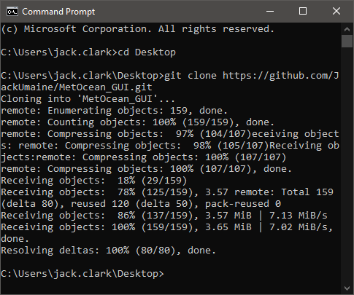
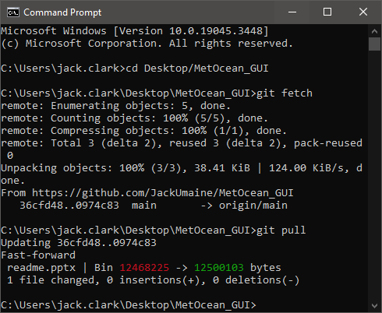
Getting the latest from GIT
2a
2b
2c
While I will always try to keep the drive folder as up to date as possible, the git repository will always have the most recent changes and allows for a place to make requests/bug reports.
Install git by contacting IT and telling them you want git and git bash.
To clone a repository –
Open a terminal window
CD to folder of interest
Type: git clone <repo address>
Confirm repository is there and contains what is it supposed to
Get the latest
Open a terminal window
CD to the repository
Type: git fetch
Type: git pull
3b
3c
3d

